Slide 1
Creating Interactive Prototypes
Jason Forsyth Ed Dorsa
PhD Student Associate Professor
ECE Department Industrial Design
Virginia Tech Virginia Tech
Notes:
Title slide. Nothing to see here.

Slide 2
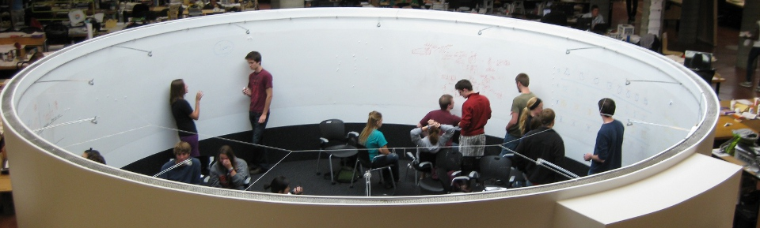
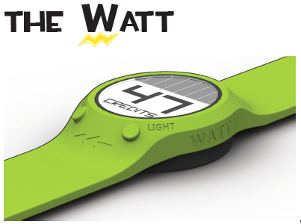
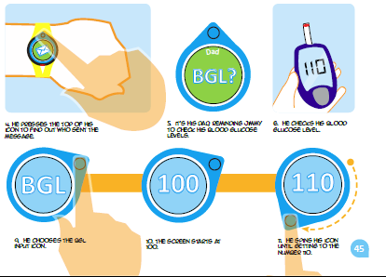
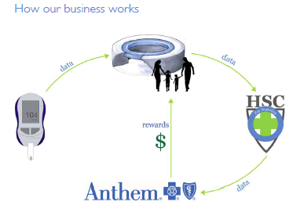
Preliminaries: Who Are We?
Notes:
Overview existing working in interdisciplinary design. Show that design and technology need a tight coupling to achieve an effective product.

Slide 3
Today
Introduce Sensors/Actuators, Scratch, Arduino
Walk through 4 examples
Input: Slide sensor, Force sensor
Output: Tri-color LED, Servo motor
Create Simple Game/Children’s Toy
Free Time
Explore the sensors
Storyboard your ideas
Notes:
General outline of the workshop. The key points are to introduce the sensors and hardware that are going to be used, and also to “unload” any terms that might be used. For example, you need to explain the difference between Power (+5V), Ground, Analog, Digital, Circuit…etc, words that are commonly understood by those familiar with the subject, but are extremely foreign to new learners. To help with this process we’ll describe each sensor as providing some information, such as light, rotation, force, and ignore their more technical names such as photocell, accelerometer, and force sensitive resistor. The same thinking applies to outputs/actuators as well.
Overall the workshop is an introduction of these terms, the sensors, a walkthrough of several examples, and then free time. In our experience, 4-5 examples is the perfect amount to get everyone comfortable and working.

Slide 4
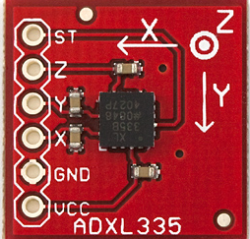
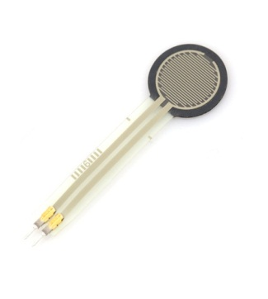
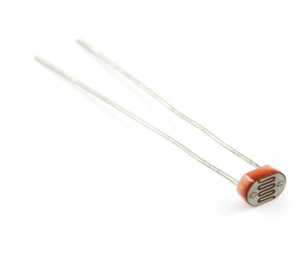
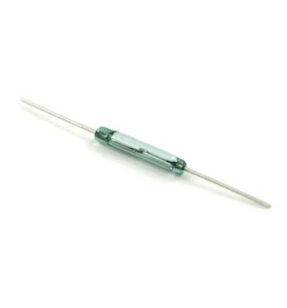
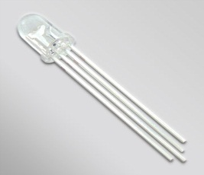
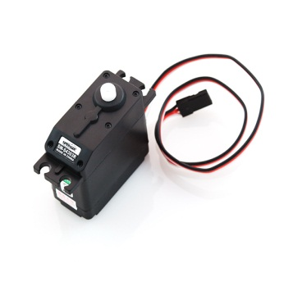
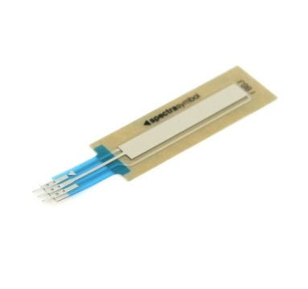
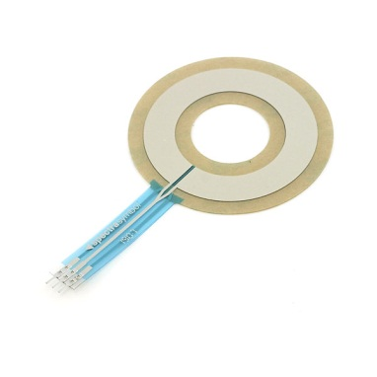
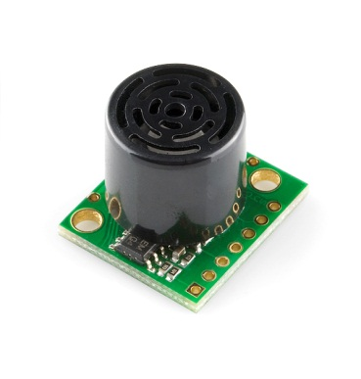
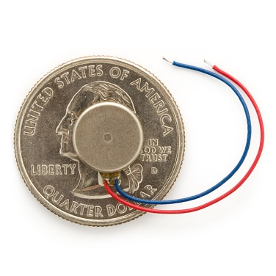
Sensors & Actuators Available
Rotation – Force – Light – Magnet – Motor – Touch – Range - Vibration
Notes:
All the sensors and actuators that we will be using today. Try to describe them in terms of the information they provide, or the things they can do. For example, an accelerometer can tell you the amount of rotation in the three axis, or it can tell you how hard it’s hit. You don’t need to explain the physics behind it, just tell people what they can sense or do with each object. However, the participants do need to know how each object works so they can understand when things go wrong. For example, the range finder has a wide sensing area that expands away from the device, thus objects in the periphery might be accidently detected. The participants need to understand information such as this to debug problems.

Slide 5
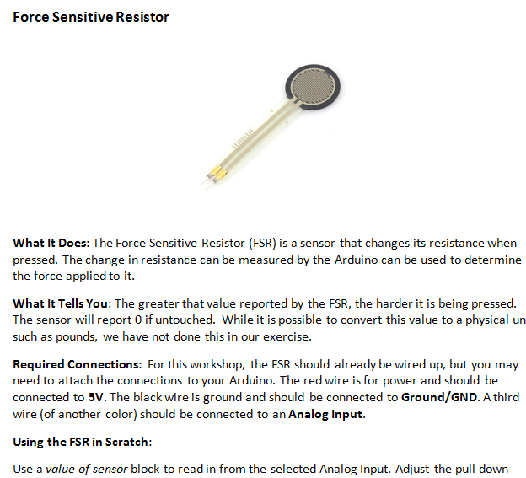
User Friendly Data Sheets
Notes:
These are user friendly data sheets that we have constructed for each object. The explain what it does, how it works, and how to hook it up to the Arduino. Additionally there are some example blocks that show how to get started with each object.

Slide 6
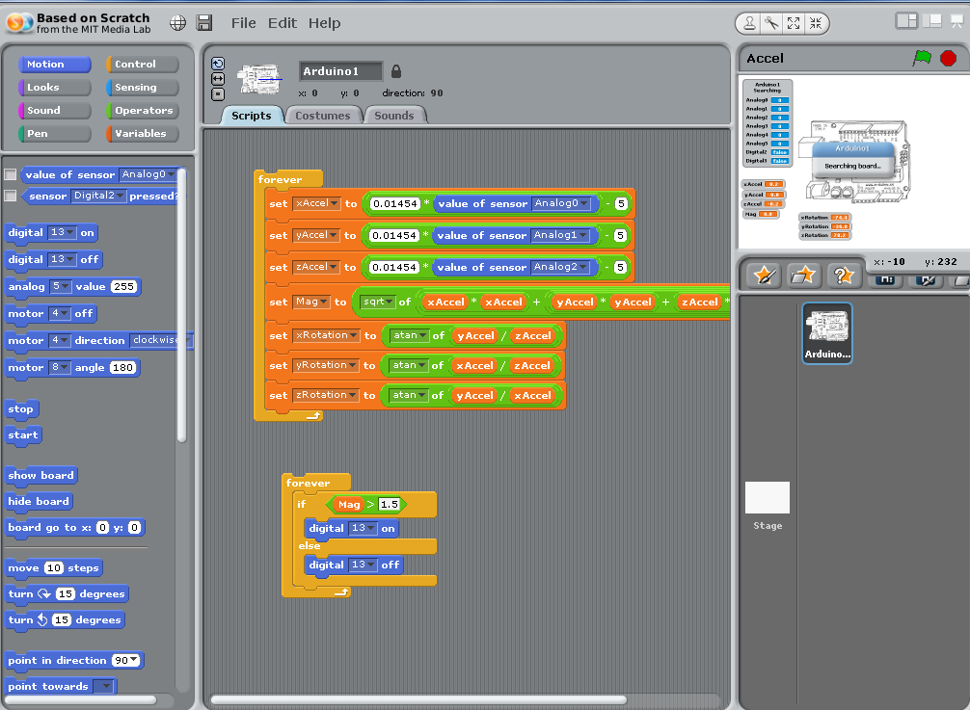
Scratch Examples for Each Sensor
Notes:
Example for the Accelerometer. Probably could skip this slide.

Slide 7
Controlling Sensors with Scratch
Programming through Blocks
Blocks are individual commands, appropriate blocks fit together like a jigsaw
Blocks stack to form a program
Four Main Groups for this Workshop
Motion (blue): send/receive data from Arduino
Control (yellow): direct the flow of your program
Operators (green): add, subtract, multiply…
Variable (orange): create and store variables
Notes:
Basic description of the Scratch language. It’s easier to learn that others and operates using a “jigsaw puzzle” metaphor. Blocks that work together fit together, and you avoid the syntax errors that plague other languages. There are many groups of blocks, but we’re only concerned with these four here.

Slide 8


Learning Through Examples
Make the LED on your Arduino Blink
Use Digital On and Digital Off blocks under the Motion Tab
Key points:
Click to activate/deactivate blocks
Blocks are like messages to the Arduino
Notes:
The most basic example, make the LED on the Arduino blink on and off. The participants can just pull down a “Digital On/Off” block and target it at pin 13. Simply clicking the block will execute the command. This example can be built up using delays and loops to make it blink at different rates and can serve as a great introduction to these concepts.

Slide 9
Moving On To Better Things….
Need to understand our Arduino board
Difference between Input / Output / Analog / Digital
Notes:
Really need to explain and unload these terms so the participants can explain how to hook up the parts on there own. The datasheets will say “Connect to Analog Input [0-5]” so they need to know the difference between digital and analog inputs.

Slide 10
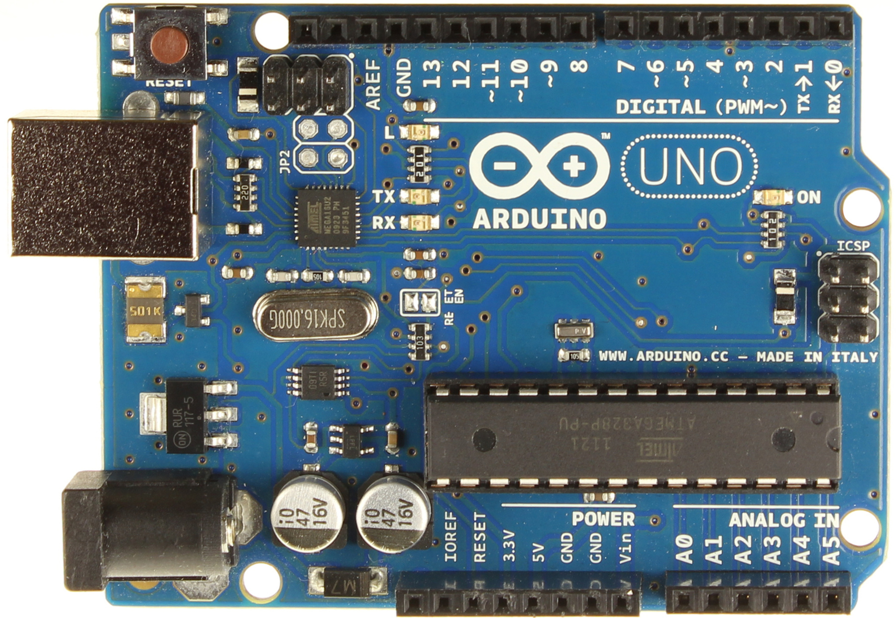
Digital Input/Output
Power & Ground
Analog Input
Notes:
Visual description of the various pins on the Arduino.

Slide 11
Servo Example
Connect Servo to Arduino
Red => 5V
Black => Ground/GND
White => Digital Input 4 or 7
Blocks
Motor Direction : rotate motor
Motor Off: stop motor
Notes:
Moving on to a bigger example with the servo. You can use the Motor Direction and Motor Off blocks to target a specific servo. This is the first time participant will be hooking up a component themselves so it’s good to overview the electrical connections that are required.

Slide 12
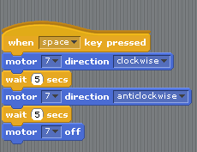
Servo Example
Notes:
Have them build this example. It will turn the motor one way for 5 seconds, then reverse direction. They can play with this example to change the delays or have it loop continuously. Let the groups explore as they will.

Slide 13
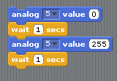
RBG LED
Notes:
Use the analog block to turn on and off the LED attached to pin 5.
After everyone is comfortable with the servo example, you can move on to the LED. This should already be wired up as the pin connections aren’t obvious. It’s good practice to attach a colored wire to each LED color. For example, the pin that controls the red LED has a red wire. That way the participants can hook it up themselves, but they know red wire means red LED and can remember which analog pin that is.
The example can be augmented with loops or different delay to create different color patterns. Also, there can be other independent blocks controlling the other LEDs. The next slide will show an advanced version of this involving loops and variables.

Slide 14
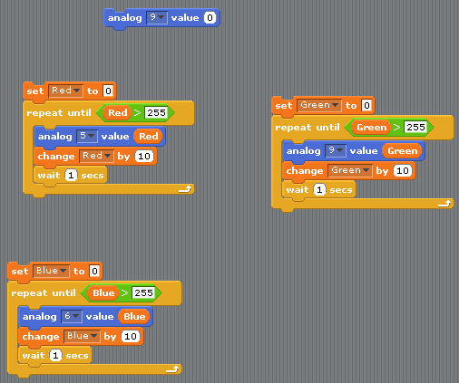
RGB LED
Notes:
Advanced version of the LED example. You can have the participants build this, without explaining it, and then go line by line to describe what each block does. This serves as a good introduction to variables, loops, and parallelism. This should be the most advanced concepts you need to cover. The analog 0 block at the top of the example is good way to turn off any LEDs with a single command.

Slide 15
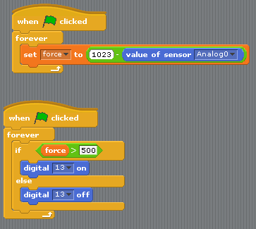
Sliders / Force
Notes:
This example connects a sensor to an LED and shows participants how to link input and output. They will need to create a variable called “force” to store the sensor readings. For this particular sensor, it is difficult to translate the sensor reading to a physical unit, so we will just use the raw units and say “0 is no force, 1023 is max force”.
At this point we’ve covered enough inputs, outputs, and programming concepts that everyone should be comfortable on their own. If you want, there are examples of how to work each sensor on their respective datasheets You can continue to go through those, or just let them play.

